Slide 1
19Z604 Embedded Systems
Dr.N.Arulanand,
Professor,
Dept of CSE,
PSG College of Technology

Slide 2
Resource Sharing
Resource Sharing among real-time tasks
CPU is a serially reusable resource
Can be used by one task at a time
The task can be preempted at any time without affecting correctness
Other resources:
files, data structures, Memory, devices,
These resources need to be used in preemptable mode.

Slide 3
Resource Sharing
Critical Section
A part of the section in while a shared non-preemptable resource is accessed
Traditional solution in Operating System to execute critical section
Semaphores
In Real-time systems, the solution doesn’t work. It leads to
Priority Inversion
Unbounded Priority Inversion

Slide 4
Priority Inversion
Priority Inversion
Priority inversion is a situation in which a low-priority task executes while a higher priority task waits on it due to resource contentions
Consequences in Real time system
If a task cannot be preempted (a low priority task) while computing a critical section
The higher priority task keeps waiting
Task Scheduling Algorithm: Low Priority task should yield to Higher priority task (ex: RMA) .
Basic assumption in Real Time Task Scheduling is Higher Priority will execute first....

Slide 5
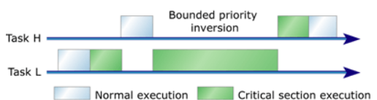
Bounded Priority Inversion

Slide 6
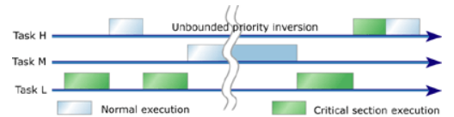
Unbounded Priority Inversion
A complex problem than bounded priority inversion
Situation: Low priority task is holding a resource.
After some time, High priority task executes and waiting for TL to complete
Intermediate tasks, which doesn’t need to resource preempts to low priority task.

Slide 7
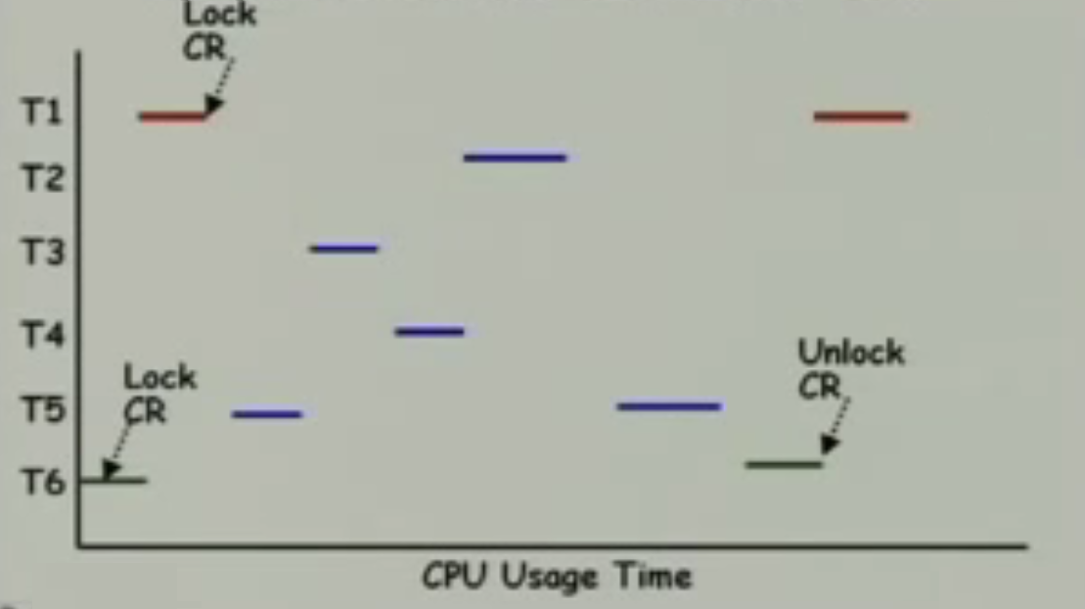
Unbounded Priority Inversion Example
T1 has highest priority; T6 has lowest priority
T1 Missing deadline....

Slide 8
Mars PathFinder
4th July 1997, landed on the Mars surface
Bounced on the martian surface, surrounded by airbags
Deployed the Sojourner Rover
Gathered and transmitted enormous data to the earth

Slide 9
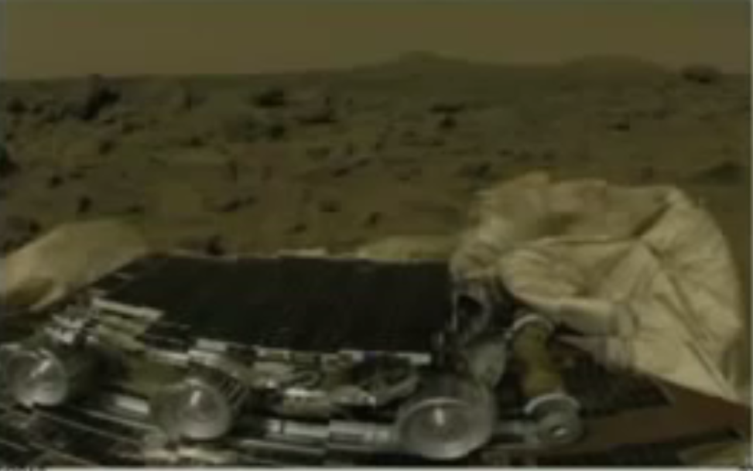
Mars PathFinder – Sojourner Rover

Slide 10

Pictures from Mars PathFinder

Slide 11
Mars PathFinder Gitch
Often started Resetting
They were using real-time kernel from Wind River Systems Ltd – VxWorks RTOS
VxWorks can run in Trace mode:
Events like context switching, use of synchronisation objects and interrupts are recorded
Replicate the precise condition for reset
Unbounded priority inversion was occurring
Found global variable to initialize the Priority Inheritance was turned OFF

Slide 12
Solution to Priority Inversion
How to make a task complete as early as possible ?
Priority Inheritance Protocol
Priority Ceiling Protocol

Slide 13
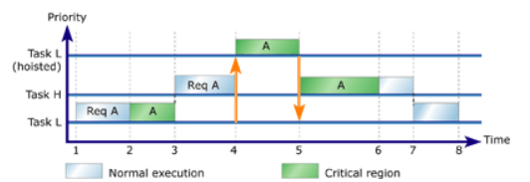
Priority Inheritance Protocol
Raise the priority of Low Priority Task (if it’s holding the resource of higher priority)
The priority is raised to the level of the task that is holding the resource.

Slide 14
Priority Inheritance Protocol
As soon as the task release its resource,
It gets back to its original priority value if it holding no other critical resource
If in case, its holding other critical resources:
It inherits the priority of the highest priority task waiting for resource.

Slide 15
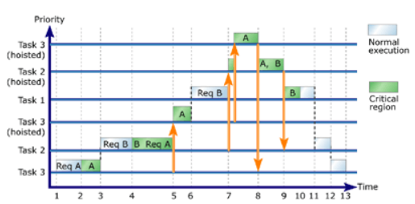
Three Tasks and 2 resources

Slide 16
Priority Inheritance Protocol
PIP resolves unbounded priority inversion issue.
These two issues still persist:
Deadlock
Chain Blocking

Slide 17
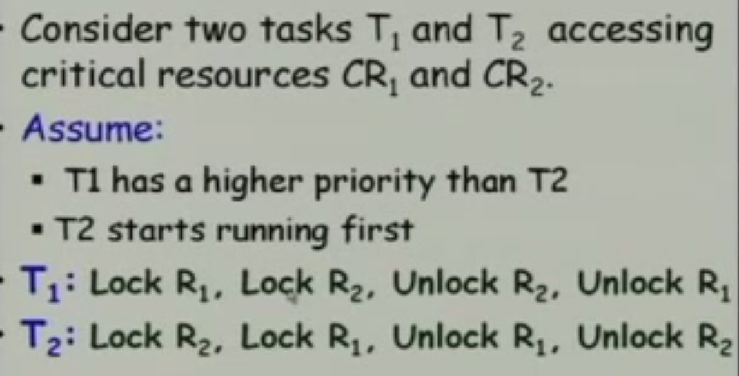
Deadlocks

Slide 18
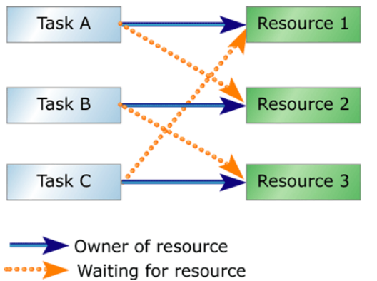
Deadlock – Example 2

Slide 19
Chain Blocking
Each time a Task needs a resource, it needs to undergo priority inversion
Example: A high priority task T1 needs several resources.....from other tasks...

Slide 20
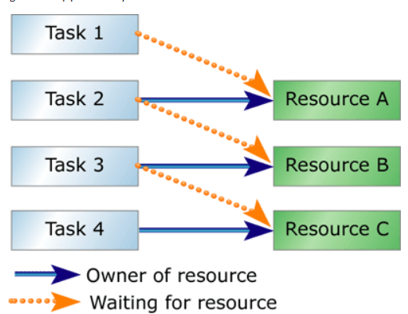
Chain of Nested Resource Locks

Slide 21
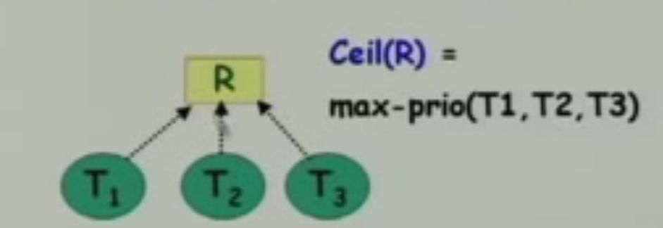
Priority Ceiling Protocol
Ceiling priority of a resource
As soon as a task acquires a Resource, it’s priority value is raised to the ceiling priority of that resource

Slide 22
Priority Ceiling Protocol
Solves the problem of unbounded priority inversion, deadlock and chain blocking

Slide 23
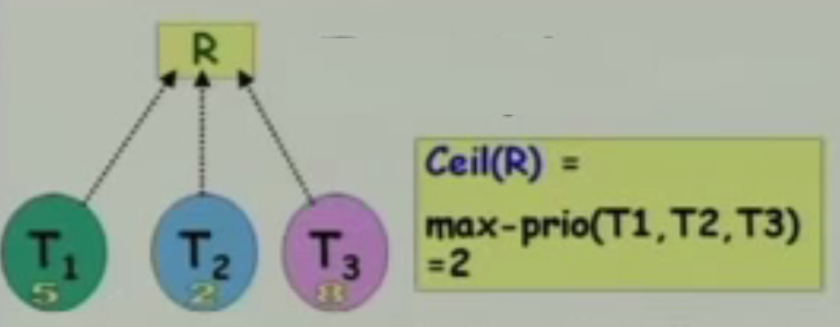
Example
In Unix, lower priority value indicates higher priority
In Windows, lower value indicates lower priority

Slide 24
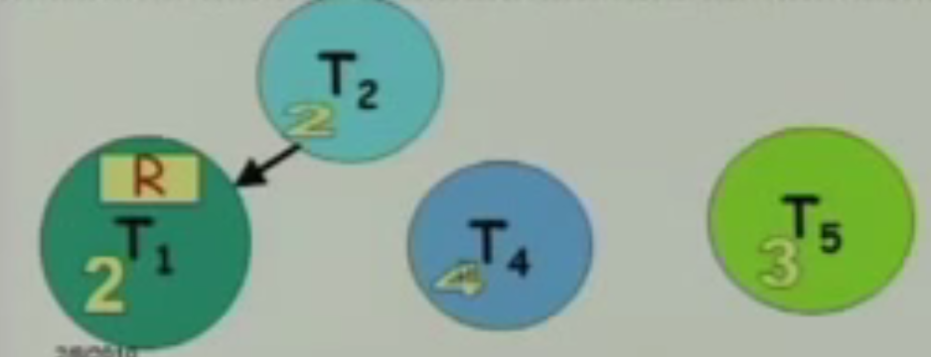
Priority Ceiling Protocol
Unbounded priority inversion is resolved

Slide 25
Priority Ceiling Protocol - Issues
Inheritance Blocking:
When a priority value of a low priority task holding a resource is raised to higher value
Intermediate priority tasks not needing the resource, cannot execute and hence undergo priority inversion.....
Practically, it’s not possible to know when a resource is needed by a task...

